Slide 1

Topic- SOAP VS. REST in SOA
Guided By- Vidya Jaykumar Ma’am
Student Name- Kalyani R. Waghmare
Vinayak Vyas

Slide 2
SOAP vs. REST in SOA
A Comparison

Slide 3
Content :
1. Introduction to SOAP
2. Overview of SOAP
3. Overview of REST in SOA
4. Differentiate Between SOAP vs REST in SOA
5. When to Choose SOAP
6. When to Choose REST in SOAP
7. Conclusion

Slide 4
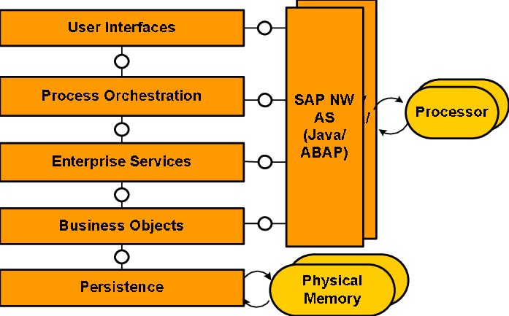
Introduction to SOA
SOA is an architectural style for creating and using services in distributed systems.
It involves loosely coupled, independently deployable services that perform specific functions.
SOA is crucial for building adaptable, maintainable systems, especially in complex enterprise and cloud environments.
Web services are a common implementation of SOA principles for distributed component communication.
It provides feature such as modular design, loose coupling,Reusability,interoperability,flexibility,scalability.

Slide 5
SOAP (Simple Object Access Protocol)
SOAP is a protocol for exchanging structured information in the implementation of web services.
SOAP is XML-based, strongly typed, and includes built-in error handling.
SOAP uses a request-response model, making it suitable for synchronous communication.
SOAP is known for its high level of interoperability among different platforms and programming languages.
SOAP is typically used in enterprise-level applications and for handling complex transactions.

Slide 6
REST (Representational State Transfer)
REST is an architectural style for designing networked applications, particularly using HTTP.
REST is stateless, uses HTTP methods (GET, POST, PUT, DELETE), and is lightweight and simple.
REST is commonly used for building web APIs and is well-suited for mobile applications and public-facing services.
REST's simplicity and statelessness make it highly scalable, particularly for web-based systems.
REST allows for efficient caching mechanisms, reducing server load and improving performance.

Slide 7
SOAP vs. REST - Pros and Cons
SOAP (Simple Object Access Protocol) | REST (Representational State Transfer)
SOAP is a protocol Type | REST is an architectural style.
It follows a strict request-response model. | It follows a flexible client-server interaction style.
SOAP can be more complex due to its XML structure. | REST is generally simpler and more lightweight.
It has built-in standards for security and transactions. | REST relies on external standards for security and transactions.
SOAP has built-in error handling mechanisms. | Error handling is typically left to the developer's implementation.
Commonly used in enterprise-level applications and scenarios requiring strong data typing and security. | Commonly used for building web APIs, mobile applications, and public-facing services. Ideal for scenarios where simplicity and scalability are essential.

Slide 8
When to Choose SOAP
Choose SOAP when you need strict data typing and built-in security features.
Prefer SOAP for enterprise-level applications and complex transactions.
Consider SOAP for scenarios where interoperability with various platforms is crucial.
SOAP provides robust error handling for reliable communication and comprehensive error reporting.
SOAP is suitable for applications requiring support for distributed transactions and adherence to ACID properties.
Choose SOAP when integrating with legacy systems or services to maintain compatibility and ensure smooth data exchange.

Slide 9
When to Choose REST
Choose REST when simplicity and lightweight communication are priorities.
opt for REST for building web APIs, mobile apps, and public-facing services.
Use REST in scenarios where scalability and flexibility are essential, and built-in security is not a primary concern.
REST's statelessness and caching capabilities make it an excellent choice for applications where server scalability and efficient data retrieval are crucial.
REST aligns well with resource-oriented architectures, making it suitable for designing APIs that are intuitive and follow a clean and organized structure.
REST leverages HTTP, which is already widely adopted, making it an ideal choice when you want to seamlessly integrate with existing web technologies and leverage HTTP's authentication and caching mechanisms.

Slide 10
Conclusion
Flexibility in Protocol Choice: Choose SOAP for enterprise apps with strong security needs, and REST for simplicity, ideal for web APIs and public services.
Performance: Consider performance trade-offs - SOAP may introduce complexity and overhead, while REST is typically lightweight and performs well.
Interoperability and Standards: SOAP offers high interoperability with built-in standards, while REST is great for web-based tech and relies on external standards.

Slide 11
Thank You

